Slide 1

Poseidon
Website for natural disasters

Slide 2
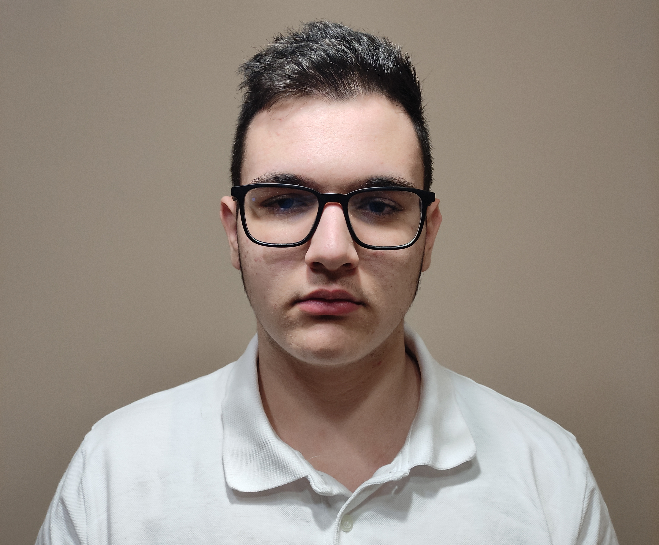
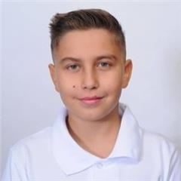
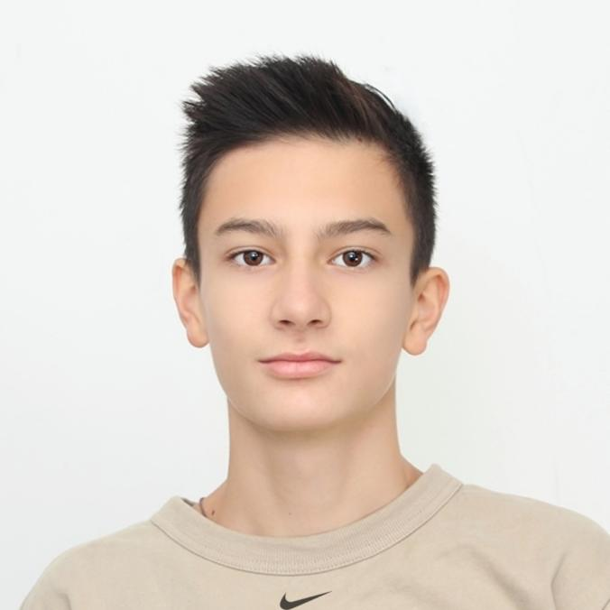
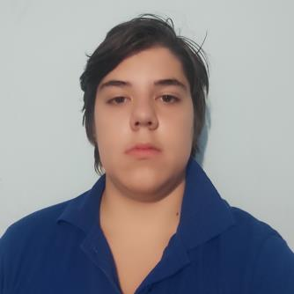
Team Members
Dimitar Yoldov
(Designer)
Georgi Kotakov
(Back-end)
Ivaylo Dimitrov
(Front-end)
Aleksandar Kostov
(Leader)

Slide 3

Process
Forming the team
Start of the project
Troubleshooting
Finding information and photos
Finishing the project

Slide 4
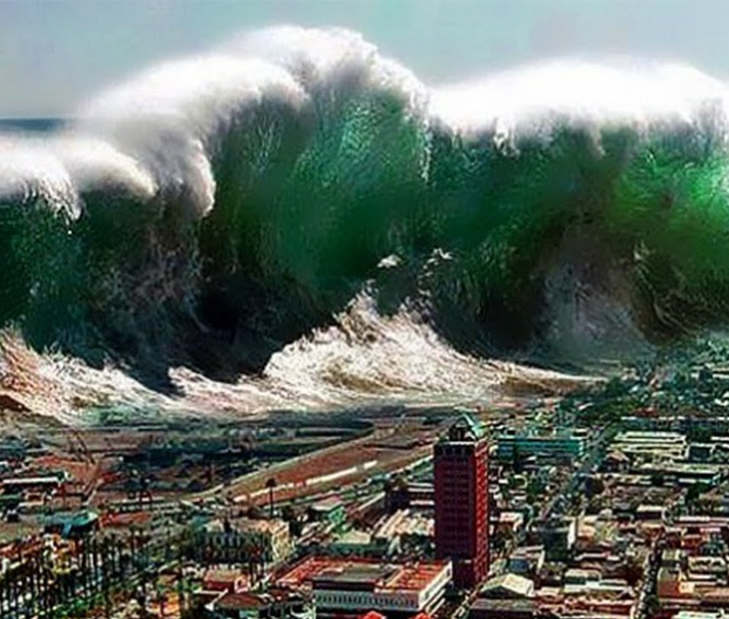
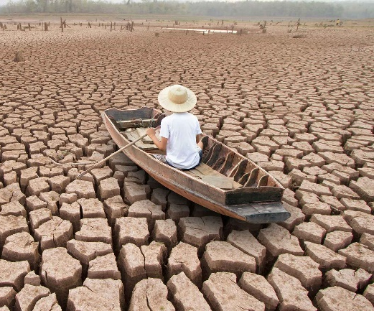
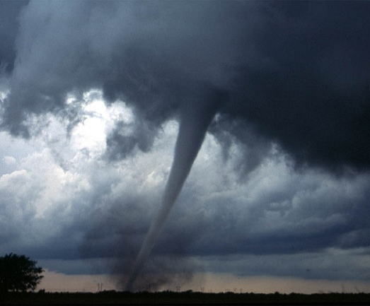
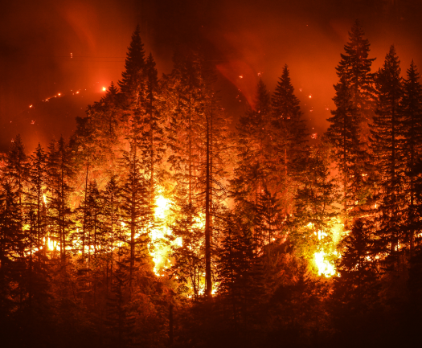
Idea
Out idea is to make a webpage with information about the different kinds of natural disasters in an understandable way.

Slide 5






Programs we used

Slide 6
Let’s go to the site

